Slide 1


NUS ISY5002, PRS -Group 11 YT Video Insight Prediction Final Presentation
5th November 2022
Nair Prashant Chathuar Balachandran A0249268N
Nakahara Hirotoshi, A0232336M
Pradeep Janakiraman, A0140188H
Vikram Sankireddypally A0249306A

Slide 2
Executive summary
Background
What we did in the project
Video analytics is gaining significant momentum because of following reasons:
Improvement of internet access across the globe.
Penetration of social media such as Facebook, Instagram, YouTube and TikTok.
Growth of the online advertising industry. The size is $556 bn in 2021 and expected to grow to $616 bn in 2022.
Measurement of quality of videos is a crucial theme for the monetization
More consumer watch duration, creators or advertisers can expect more benefit from the video exposures.
However, the existing products may not be enough because of:
Only using metadata (example)
No implication about video contents in terms of creative things creators can control.
We designed and demonstrated a system to predict following metrics of YouTube videos:
View count
Like count
To do that, we utilized following tools and technologies:
YouTube-dl API to download YouTube videos & the metadata.
FF mpeg tool to cut the videos into sliced images.
Developed a deep learning model using Keras TensorFlow.
Based on the above input data, we developed a deep-learning model to predict the metrics
Input data (X): thumbnails, 18 sliced video images, metadata (height, width, fps, duration)
Output data (y): view count & like count
Structure: combination of different DL models such as LSTM, CNN
Video Scope : Limit the video categories within dog & cat
Volume of samples: 1,207 videos

Slide 3
Product Technical Architecture
Thumbnail images
youtube-dl (API to download metadata, videos)
18 sliced images per video
Feedback
Sliced video images
Prediction (view counts, like counts)
URL list
(YouTube BB data set)
Video cutting (FF mpeg)
Deep learning model
Model Training (batch)
1,207 videos
(average 18 secs)
Meta data (height, width, duration, fps etc.)
Model update
Metadata (height, width, duration, fps)
Input data
Video
Video cutting (FF mpeg)
18 sliced images
Front App
Deep learning model
View/like counts prediction
Thumbnail
Apply the trained model to provide prediction

Slide 4
Training Data
Data category
Description
Data source
How to get the data
Data volume
Thumbnail
Thumbnail image file of videos
YouTube
Download thumbnails/videos by using youtube-dl API based on the URL list of dog and cat category in YouTube BB dataset.
Videos are sliced by using FF mpeg package.
18 sliced images are randomly selected across sliced images.
1,207 images
Sliced video images
Sliced images of videos
YouTube
1,207 videos x 18 sliced images per video (randomly selected)
Input X
Metadata
Metadata of videos
(width, height, duration and fps)
YouTube
metadata
Download by using youtube-dl API based on the URL list of dog and cat category in YouTube BB dataset
1,207 rows x 4 columns (width, height, duration, fps)
View counts
View count of videos
YouTube metadata
1,207 rows x 3 columns (video_id, view counts, like counts)
Output y
Like counts
Like count of videos
YouTube metadata

Slide 5
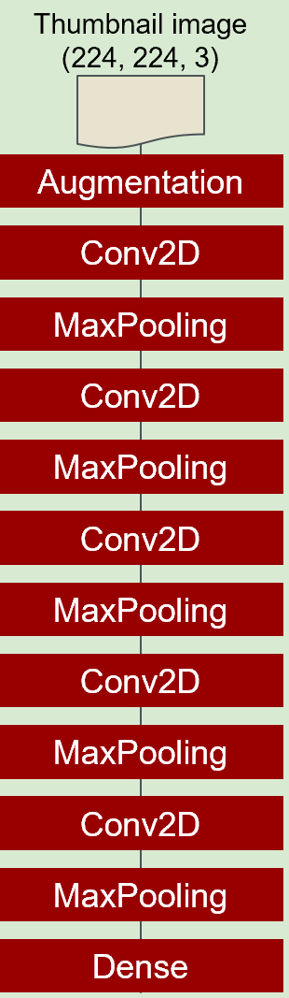
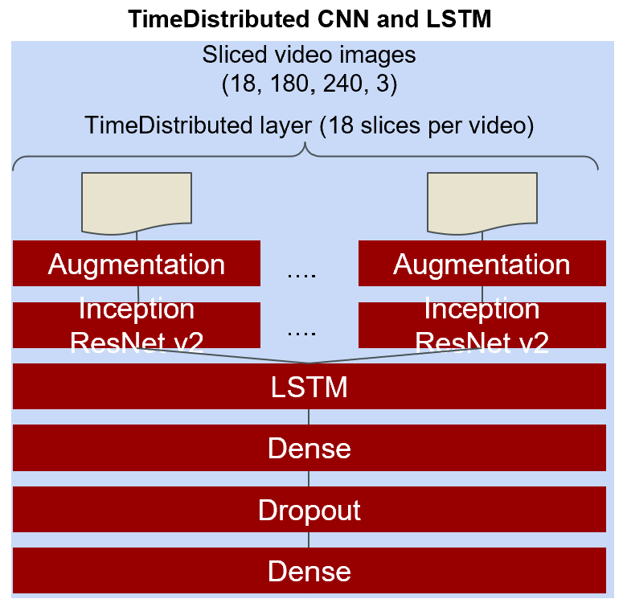
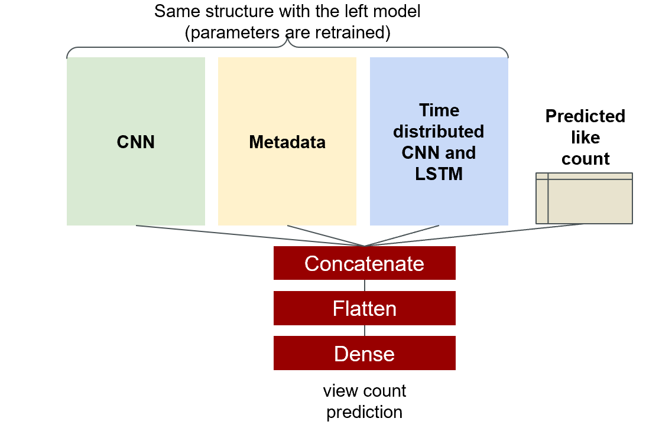
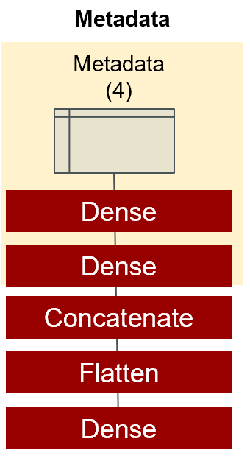
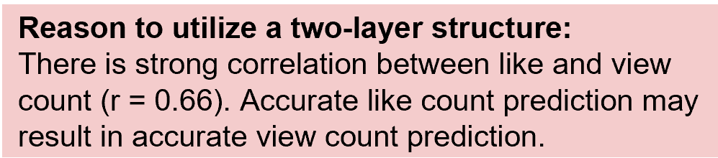
Deep Learning Model Summary
CNN
Notes:
We created a two layer deep learning model to predict like count in the first layer and view count in the second layer. This is because there is strong correlation between like and view count. In the first layer, we assigned CNN, metadata and 18 sliced imaged videos per video. “18” is based on average video length in YouTube BB data source in cat and dog categories. Sliced images videos are processed TimeDistributed CNN layer with Inception ResNet v2 model then LSTM layer extracts features in the sequential process. All modules are concatenated to predict like count. In the second layer, predicted like count in the first layer is also utilised to training the model to predict view count.
Moreover, we also assigned data augmentation layer in thumbnail module and sliced video images module. The augmentation layer such as RandomFlip, Rotation, Translation, Zoom and Contrast contributed to reduce fluctuation of prediction. We understood data augmentation layer may ensure stability of the prediction to avoid situations that small perturbation on images has large prediction difference.

Slide 6
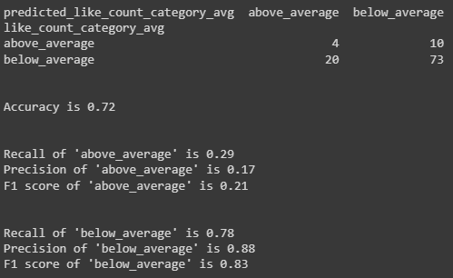
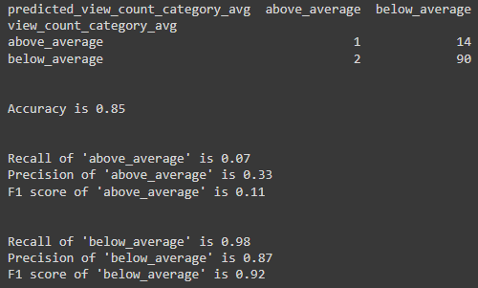
Deep learning Model Result
Metrics
Performance with 107 samples in the test data
A model with loss function mean squared error (MSE) as a regression problem is trained.
Taking into account of the difficulty to predict like and view count exactly in the prediction model, the model is evaluated as a two category classification problem (below average or above average) after the regression model creation. The metrics are:
Accuracy
Recall
Precision
F1 score
Like count prediction
View count prediction
Overall accuracy is 72%
The model can detect videos have ‘below_average’ like count with 78% recall, 88% precision and 83% F1 score
The model can detect videos have ‘above_average’ like count with 29% recall, 17% precision and 21% F1 score
Overall accuracy is 85%
The model can detect videos have ‘below_average’ like count with 98% recall, 87% precision and 92% F1 score
The model can detect videos have ‘above_average’ like count with 7% recall, 33% precision and 11% F1 score

Slide 7
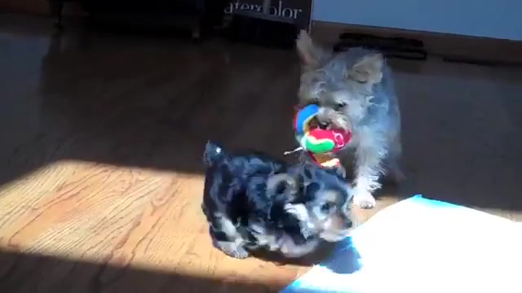
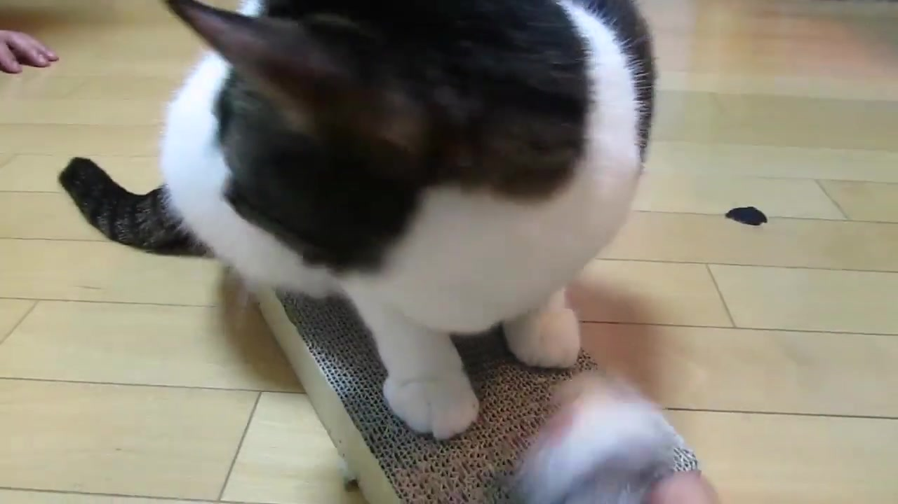
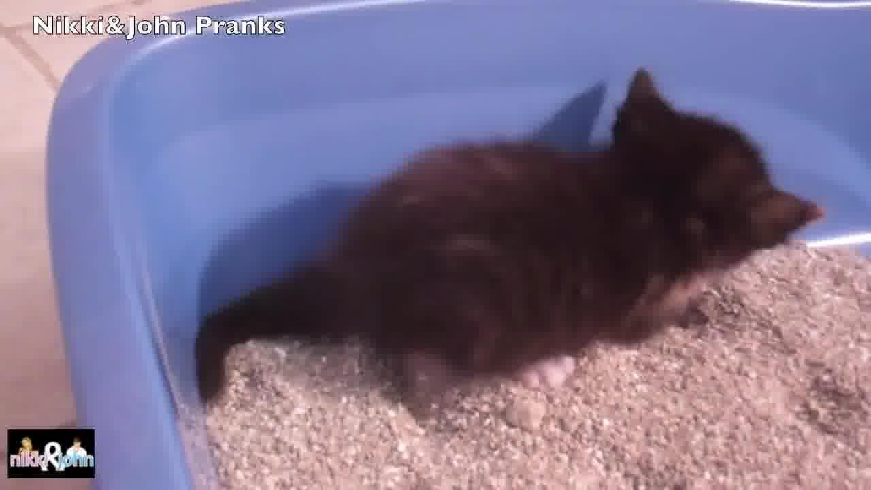
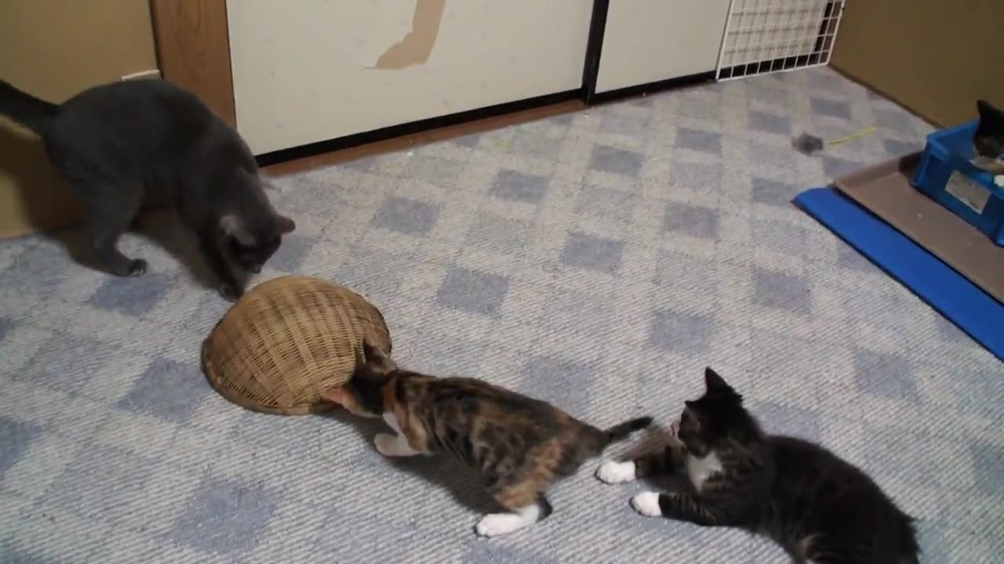
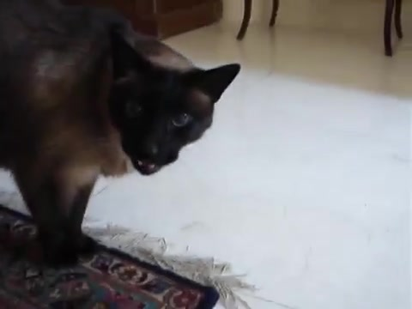

Subjective analysis of the prediction (“high like count video” by the prediction model)
Prediction: Above average Actual: Above average
Prediction: Above average Actual: Above average
Prediction: Below average Actual: Above average
Prediction: Above average Actual: Above average
Prediction: Above average Actual: Above average
Prediction: Below average Actual: Above average

Slide 8
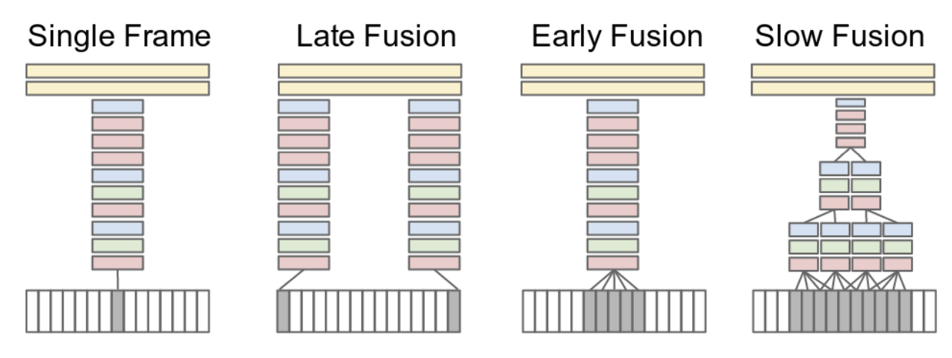
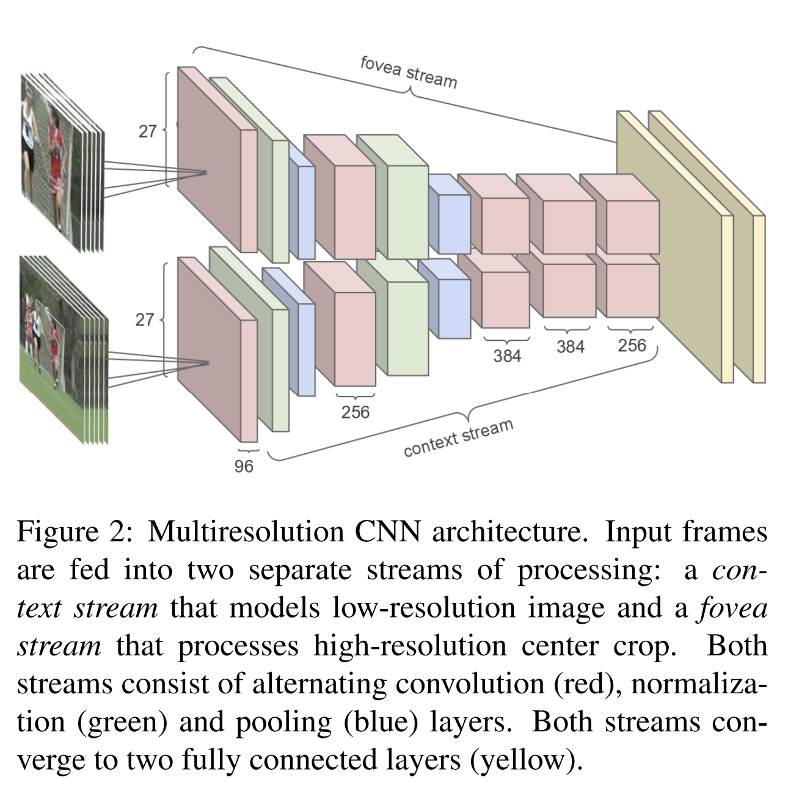
Future Enhancements
Time Information Fusion in CNNs
Concept of time fusion is used ,that is fusing information over temporal dimension through the network.
The fusion can be done early in the network by modifying the first layer convolutional filters to extend in time, or it can be done late by placing two separate single-frame networks some distance in time apart and fusing their outputs later in the processing.
Red, green and blue boxes indicate convolutional, normalization & pooling layers respectively.
Multiresolution CNN Architecture
Fovea & Context stream: The architecture aims to strike a compromise by having two separate streams of processing over two spatial resolutions (Figure 2).
E.g. : A 178 × 178 frame video clip forms an input to the network. The context stream receives the down sampled frames at half the original spatial resolution (89 × 89 pixels), while the fovea stream receives the centre 89 × 89 region at the original resolution.
In this way, the total input dimensionality is halved.
This design takes advantage of the camera bias present in many online videos, since the object of interest often occupies the centre region.
Source :karpathy14.pdf (stanford.edu)

Slide 9
Future Enhancements
Time Information Fusion in CNNs
Concept of time fusion is used ,that is fusing information over temporal dimension through the network.
The fusion can be done early in the network by modifying the first layer convolutional filters to extend in time, or it can be done late by placing two separate single-frame networks with some distance in time apart & fusing their outputs later in the processing.
Red, green and blue boxes indicate convolutional, normalization & pooling layers respectively.
Multiresolution CNN Architecture
Fovea & Context stream: The architecture aims to strike a compromise by having two separate streams of processing over two spatial resolutions (Figure 2).
E.g. : A 178 × 178 frame video clip forms an input to the network. The context stream receives the down sampled frames at half the original spatial resolution (89 × 89 pixels), while the fovea stream receives the centre 89 × 89 region at the original resolution.
In this way, the total input dimensionality is halved.
This design takes advantage of the camera bias present in many online videos, since the object of interest often occupies the centre region.
Source :karpathy14.pdf (stanford.edu)

Slide 10
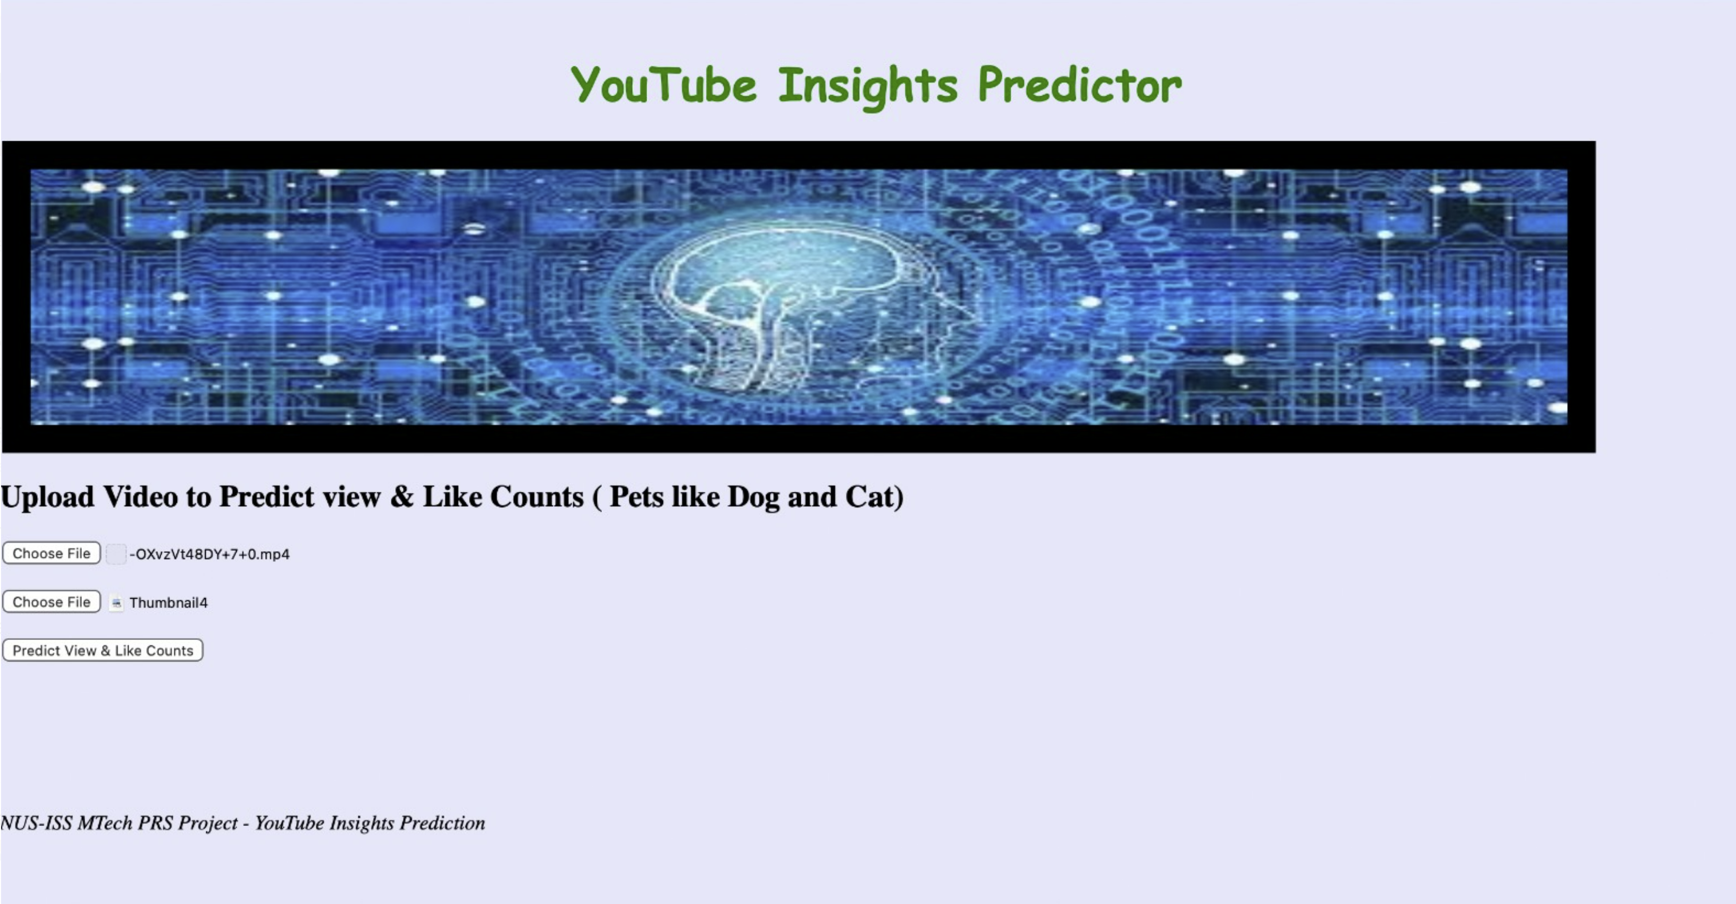
Sample Test
User uploads the Video file & Thumbnail
The uploaded video undergoes a series of extraction process to get the following 2 data:
> Retrieve meta data like fps, duration from the video
> Slice Video to images frames
Deep Learning Model predicts the Like count using the extracted data & thumbnail.
Predicted Like count will be passed to second deep learning model to predict View count.
User gets the Like and View count on the web page.
Python & Flask web framework used to integrate the developed deep learning models & UI.
UI developed in plain HTML with limited validations for user to input Video and report results.
Programming language & framework

Slide 11
NUS ISY5002, PRS -Group 11 YT Video Insight Prediction
Thank You
5th November 2022
Nair Prashant Chathuar Balachandran A0249268N
Nakahara Hirotoshi, A0232336M
Pradeep Janakiraman, A0140188H
Vikram Sankireddypally A0249306A

